Slide 1
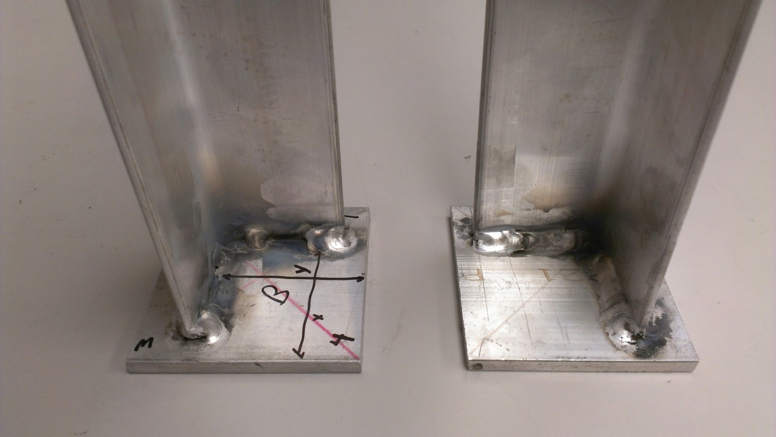
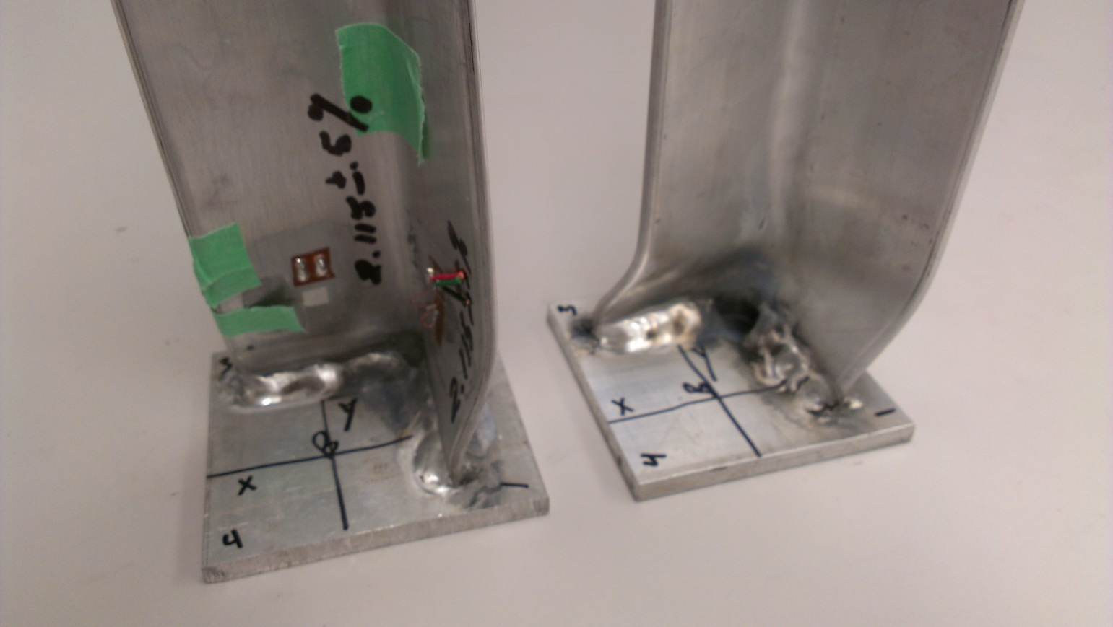
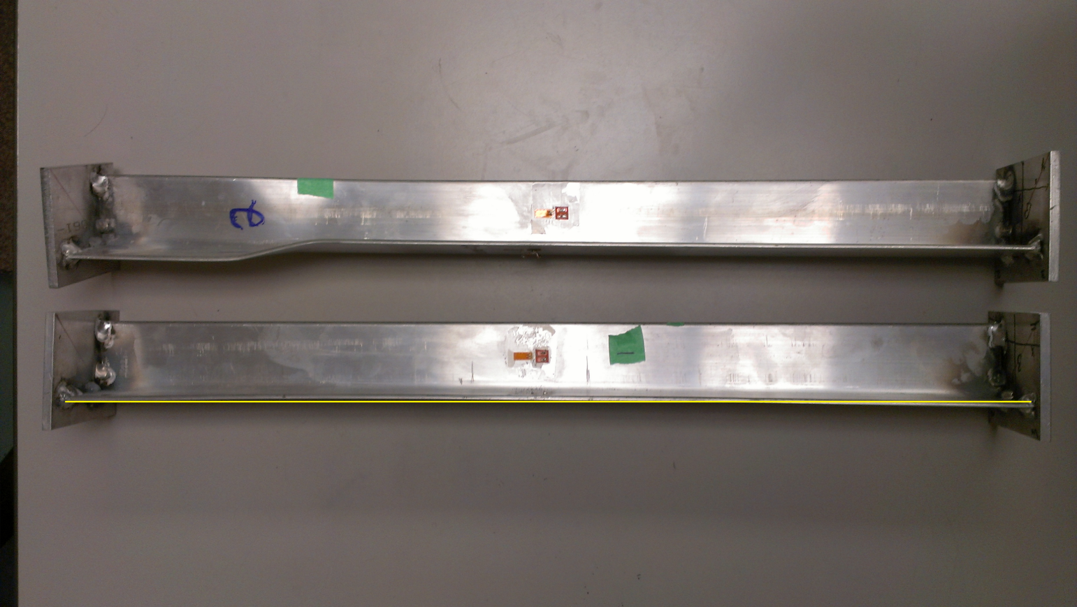
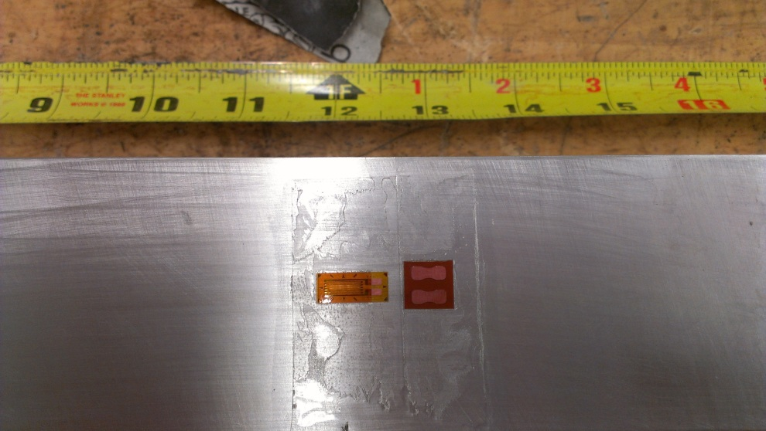
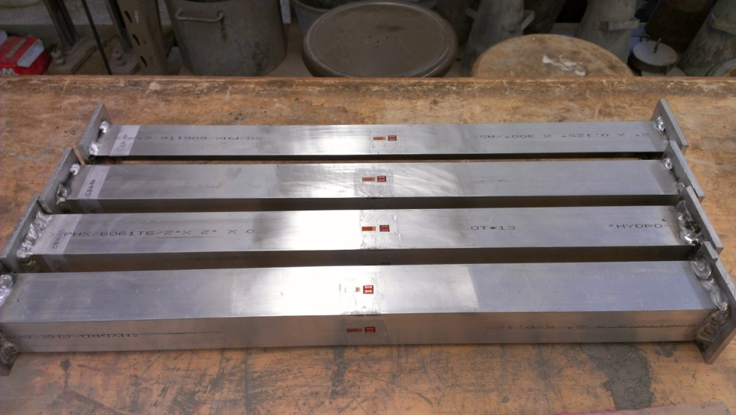
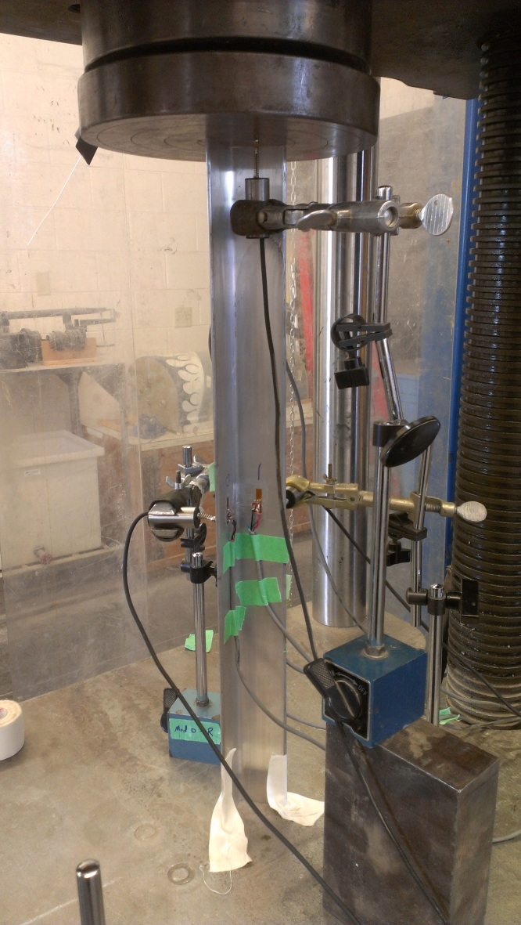
Preliminary Test Program for Friction Stir Processed Aluminum Stiffeners applicable to the Navy Littoral Combat Ship
Kyle White Research Undergraduate
Faculty Advisors; Dr. Damon Fick, Dr. Michael West
Research Experience for Undergraduates – Summer 2012
Introduction
The Navy is currently investigating the application of friction stir processing (FSP) of aluminum stiffeners as a viable option to reduce the cost and time for manufacturing while improving performance.
SDSMT has begun preliminary testing on aluminum specimens to determine the best type of boundary conditions for the actual Navy stiffeners.
Boundary conditions that under consideration are:
bearing plates fully-welded to the stiffeners
bearing plates tack-welded to the stiffeners
stiffeners without a bearing plate
Boundary conditions will be evaluated through compression loading and buckling limit states
The figure on the right shows the specimens
with a tack-welded bearing plate and a
fully-welded bearing plate respectfully.
Procedure
Strain gages were applied to specimens
Lead wires were soldered onto the strain gages
Specimens were placed in a Tinius Olsen and an axial load was applied and recorded
Left: specimen with strain gage applied
Center: fully and tack welded specimens
With strain gages applied
Right: specimen placed inside a Tinius Olsen
Results to Date
The specimens failed at an average load as follows:
Fully-weld: 8465 lbs.
Tack-weld: 10066 lbs.
No-weld: 8175 lbs.
The figure below is a comparison of maximum loads of each specimen with the specified boundary condition to determine restraint.
Conclusion
Tack-welded specimens exhibited a change in slope at 87% of the maximum load. A slight “bow” was observed in the second linear section and the permanent deformations began happening on the down slope of the load displacement curve.
Tack-welded specimens exhibited bilinear behavior in both specimens.
No-weld specimens exhibited bilinear behavior in S5.
Due to the high loads, consistencies in failure mechanisms, and the minimal mechanical property changes, the tack-welded plates will be used in the Navy stiffener testing program.
Future Work
SDSM&T will continue the testing of the Navy stiffeners. The testing program includes:
test stiffeners in compression and in bending
test coupons in tension, fabricated with both methods
quantify their section properties and behavior.
The properties will be used to validate a Finite Element Model (FEM) of different panel geometries. Further completion of this work will cover structural testing of the stiffened marine panels for a second validation of the FEM. The overall objective of these tasks is to determine a quantifiable performance and fabrication benefit to using FSP stiffeners on the LCS.
Acknowledgments
I would like to thank Dr. Michael West for giving me the opportunity to work with some of the brightest students around the country, thank you Dr. Damon Fick, Dr. Lidvin Kjerengtroen, Lucas Fried, and Kyle Johnson for allowing me to be a part of the research team, and thank you Dr. Alfred Boysen for showing us everything we need to succeed in our professional careers. A special thank you to the NSF REU Site Award #1157074 to allow students to gain experience and knowledge in research.
Left: Fully-welded plates with failure at the support.
Right: Tack-welded plate with failure outside the support.
Failure Mechanism
Failure at the support occurred in the fully-welded plates this may have occurred due to changes in mechanical properties when welding was performed.
Failure outside support occurred in the tack-welded plates, resulting in the highest buckling loads of the three boundary conditions tested.

